Slide 1

Welcome to your English Class
By Mrs. Karol Ortega

Slide 2

Unit 4
Food and restaurants
Content: Vocabulary:
Parts of a meal
Categories of food
Degrees of hunger
Communicating with a waiter
or waitress
Adjectives to describe the
healthfulness of food.
Objective: Design a menu for a restarutant.
Organize information about food, drinks, desserts and apetizers.

Slide 3
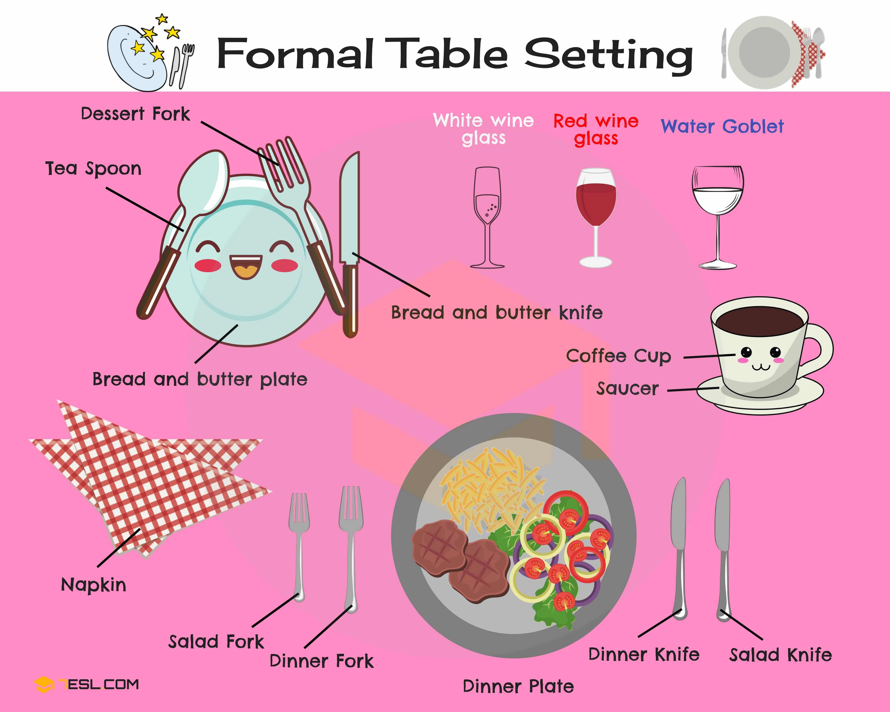

Slide 4
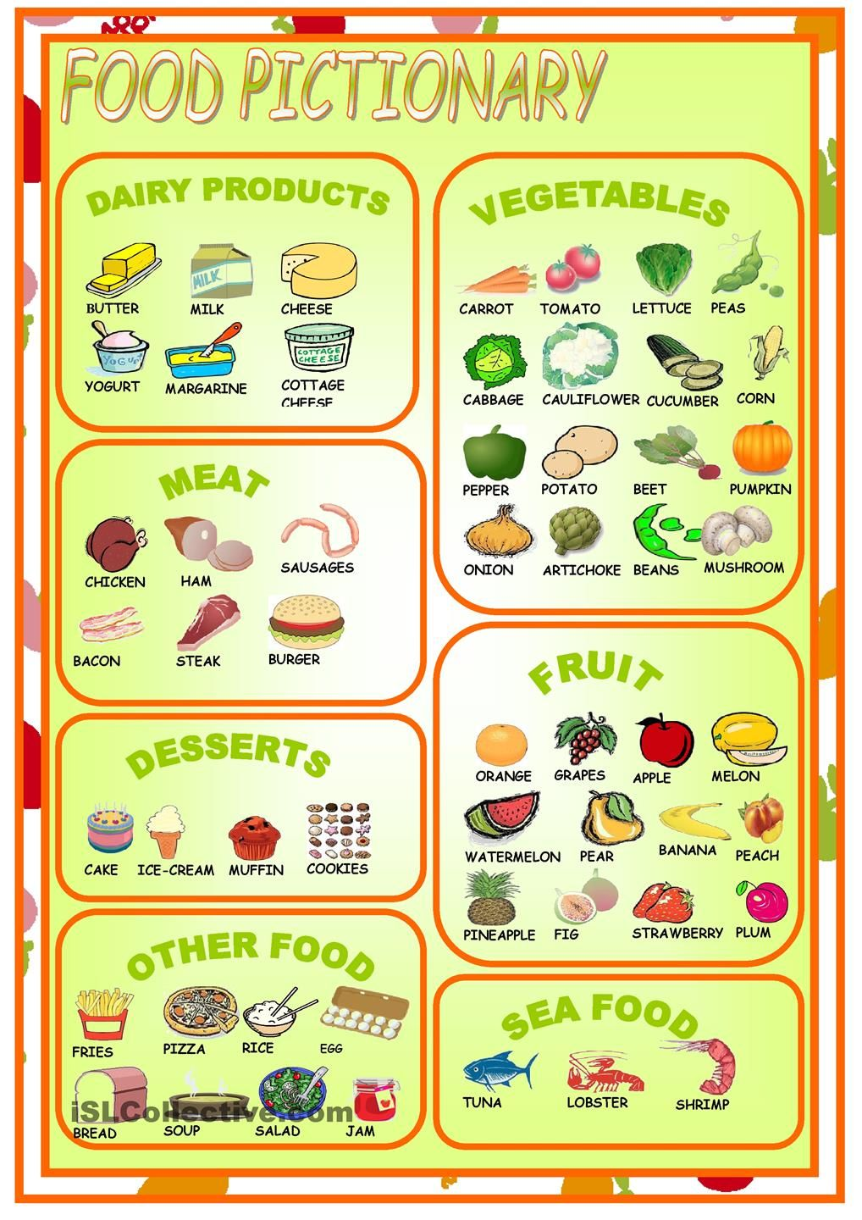

Slide 5

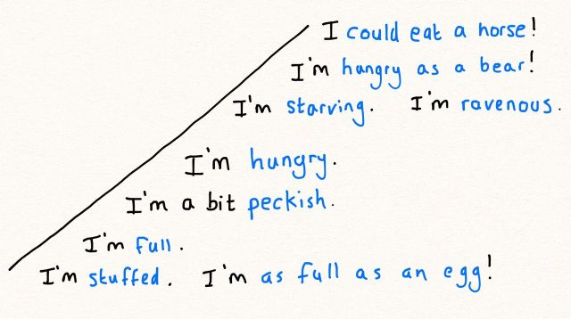
Degrees of hunger

Slide 6
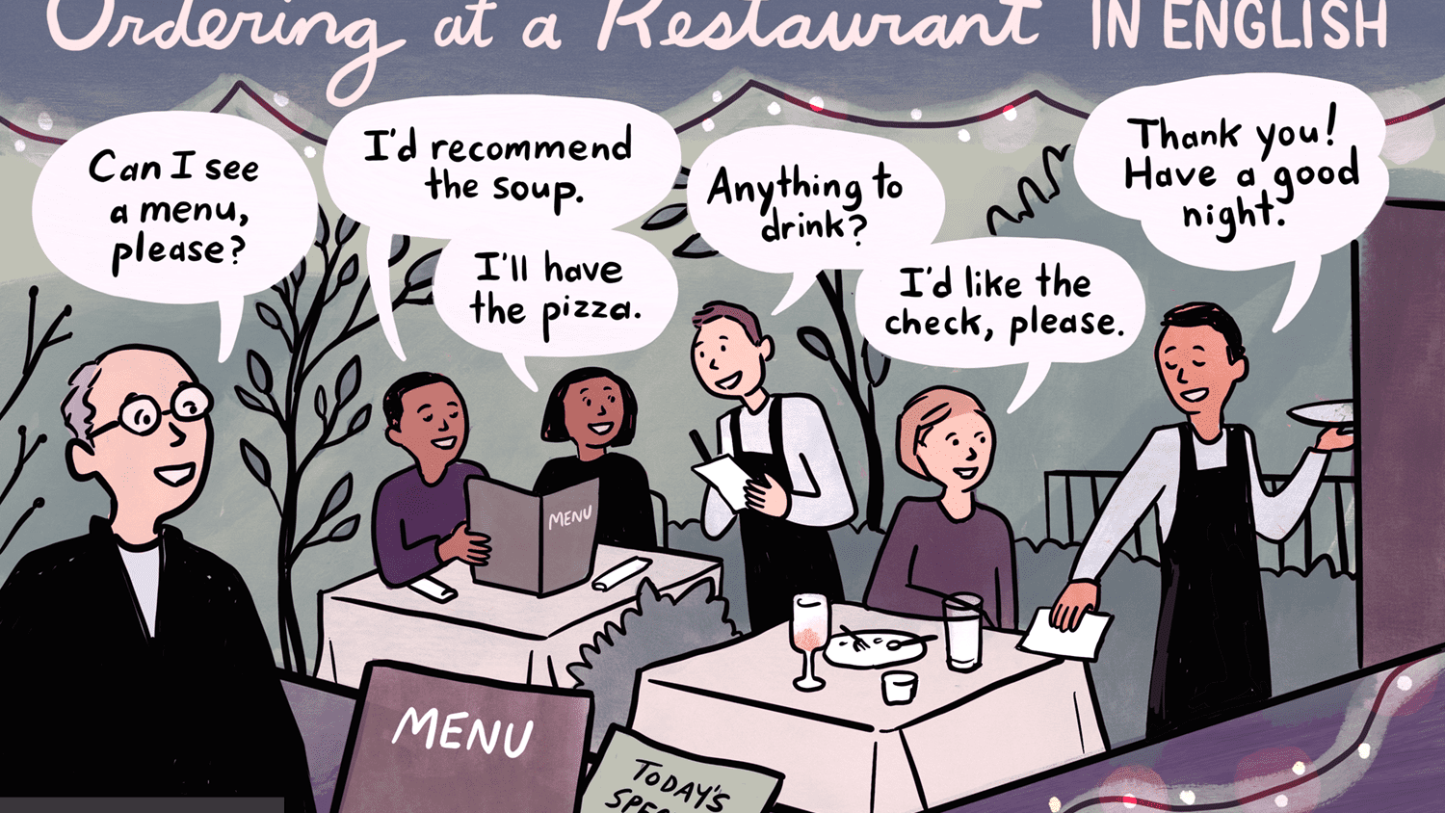

Slide 7
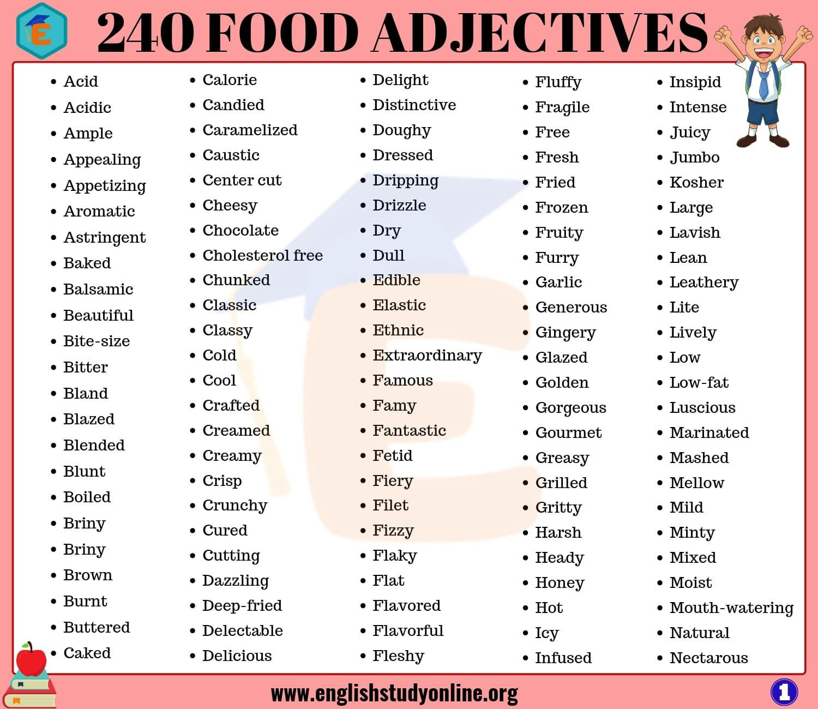

Slide 8
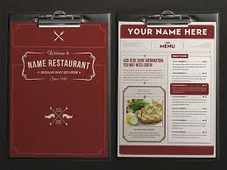
examples

Slide 9
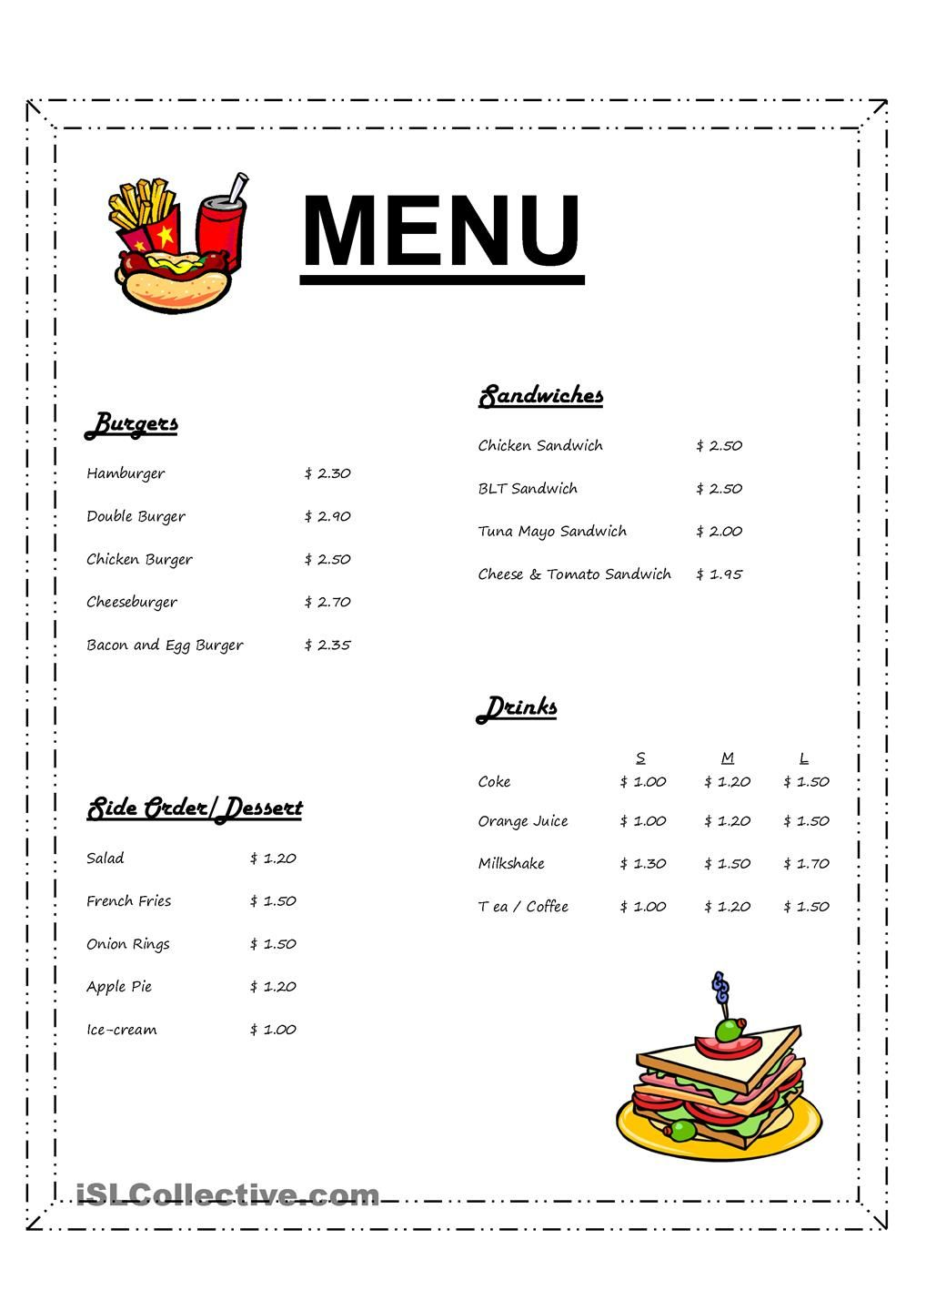
Task 2
Create or Design a menu for a restaurant.
After you finish the family tree send your file to my email: guia9calasanz@gmail.com
Due day: May 20 th, 2020
Score: 20 pts.

