Slide 1

Welcome to your English Class
By Mrs. Karol Ortega

Slide 2

Unit 4
Reading for pleasure
Content: Vocabulary:
Genres of books
Ways to describe a book
Some ways to enjoy reading
Objective:
Identify different book genre.
Describe a book using nouns and adjectives

Slide 3
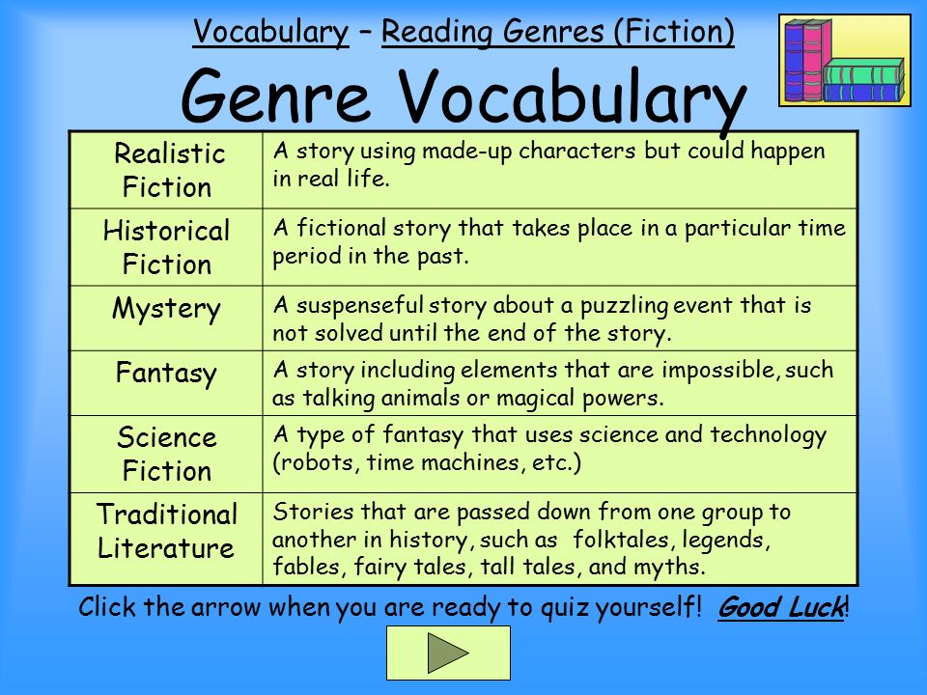

Slide 4
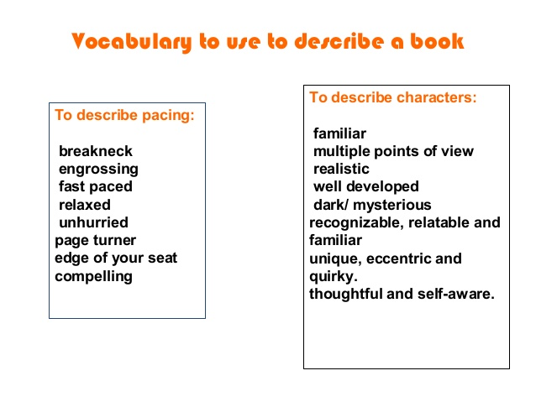

Slide 5
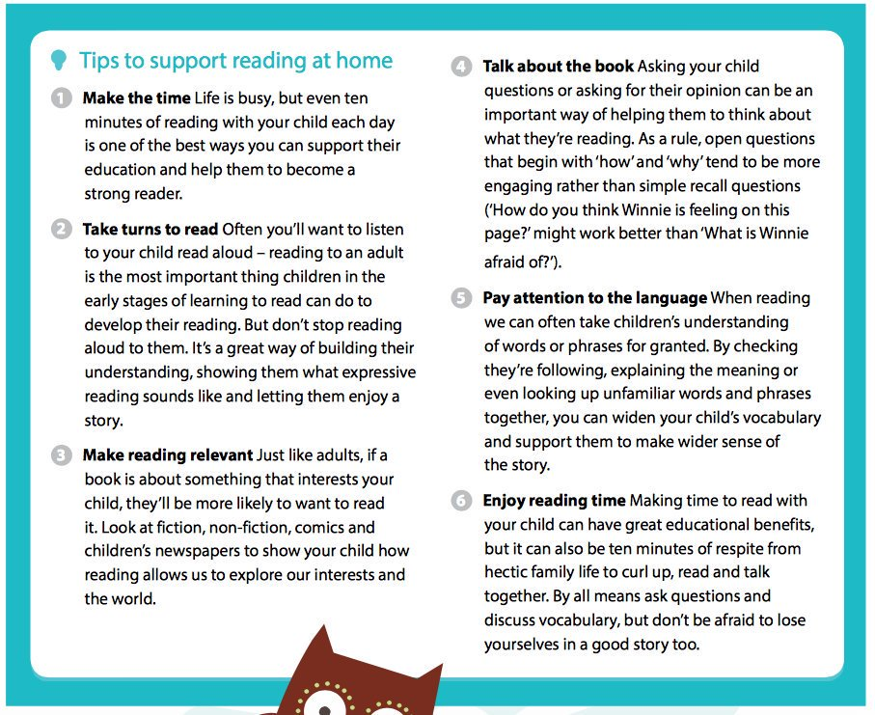

Slide 6

Book presentation
Choose a book of your preference genre.
Read it!
Then write and present the summary of your book. Include a brief descriptions of the main characters.
Also answer these few questions:
What is/was your favorite part?
What good message you take with you from the book?

Slide 7

Task 2
After you finish the task send your file to my email: guia9calasanz@gmail.com
Due day: May 20 th, 2020
Score: 20 pts.

