Slide 1

Welcome to your English Class
By Mrs. Karol Ortega

Slide 2
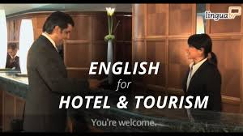
Unit 3
Staying in hotels
Content: Vocabulary:
•Hotel room types and kinds
of beds.
• Hotel room amenities and
Services.
Objective:Design a digital or paper-based touristic brochure to offer hotel room types, amenities and different services.

Slide 3
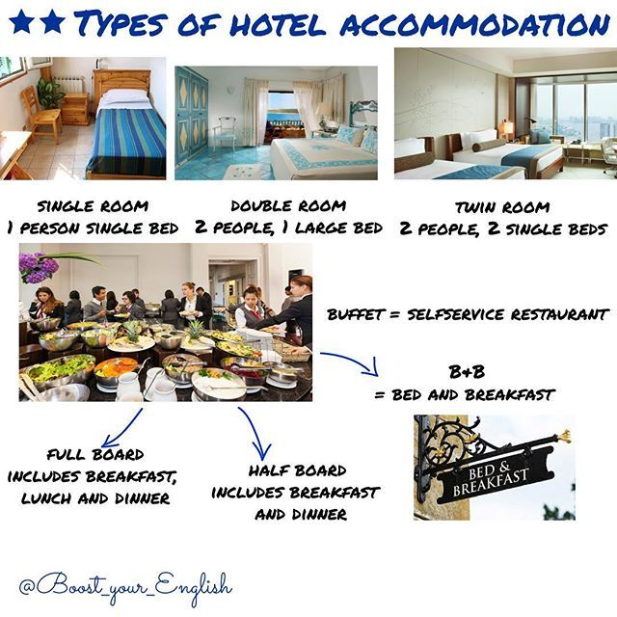
Relationships and marital status

Slide 4
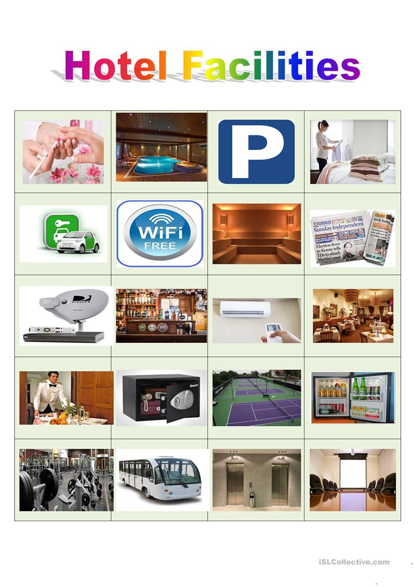

Slide 5
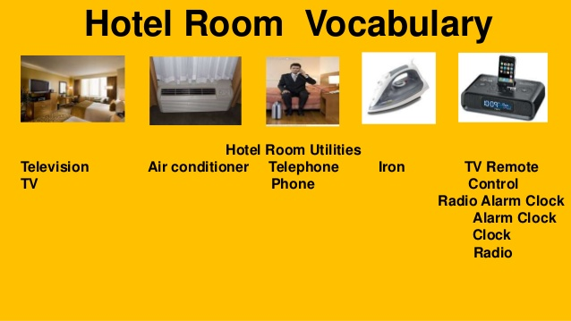

Slide 6
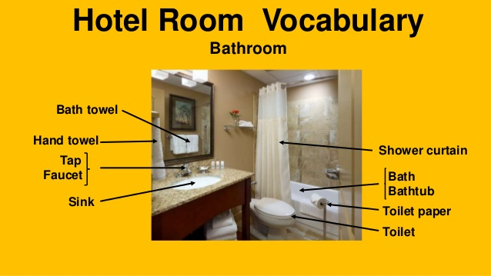

Slide 7
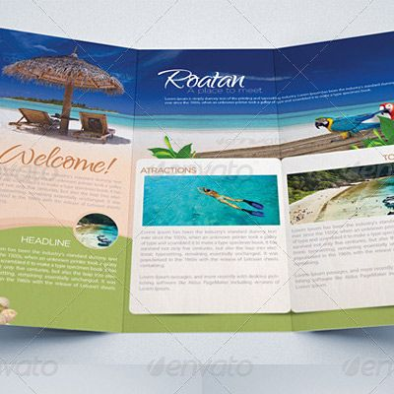
Task 1
Create a touristic Brochure.
You can give your original name to your hotel. Explain your services and amenities a customer can enjoy in your hotel.
After you finish the touristic Brochure send your file to my email: kortega@colegiocalasanz.edu.ni ó guia9calasanz@gmail.com
Due day: May 13 th, 2020
Score: 20 pts.

