Slide 1

Welcome to your English Class
By Mrs. Karol Ortega

Slide 2

Unit 3
Getting things done
Content: Vocabulary:
Ways to indicate acceptance
Services
Planning and running an event
•Objective:
Design a digital or paper-based brochure/wall-paper to promote a social event
Organize information in a wall-paper or brochure

Slide 3
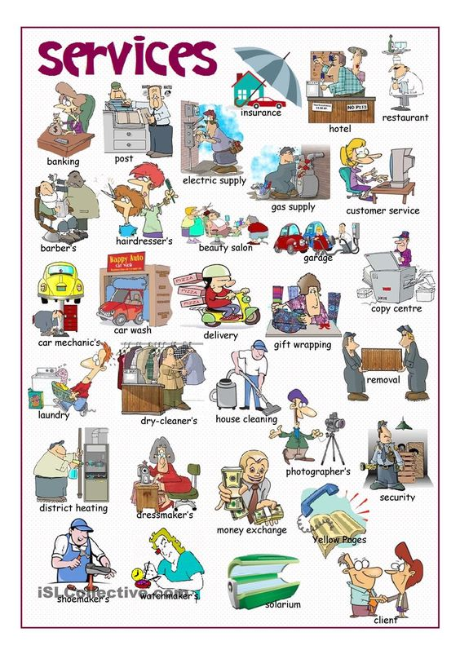

Slide 4
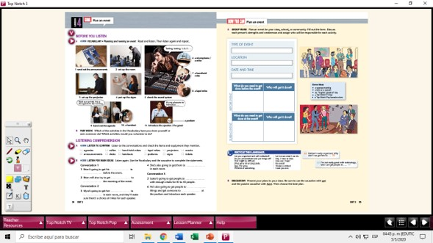

Slide 5
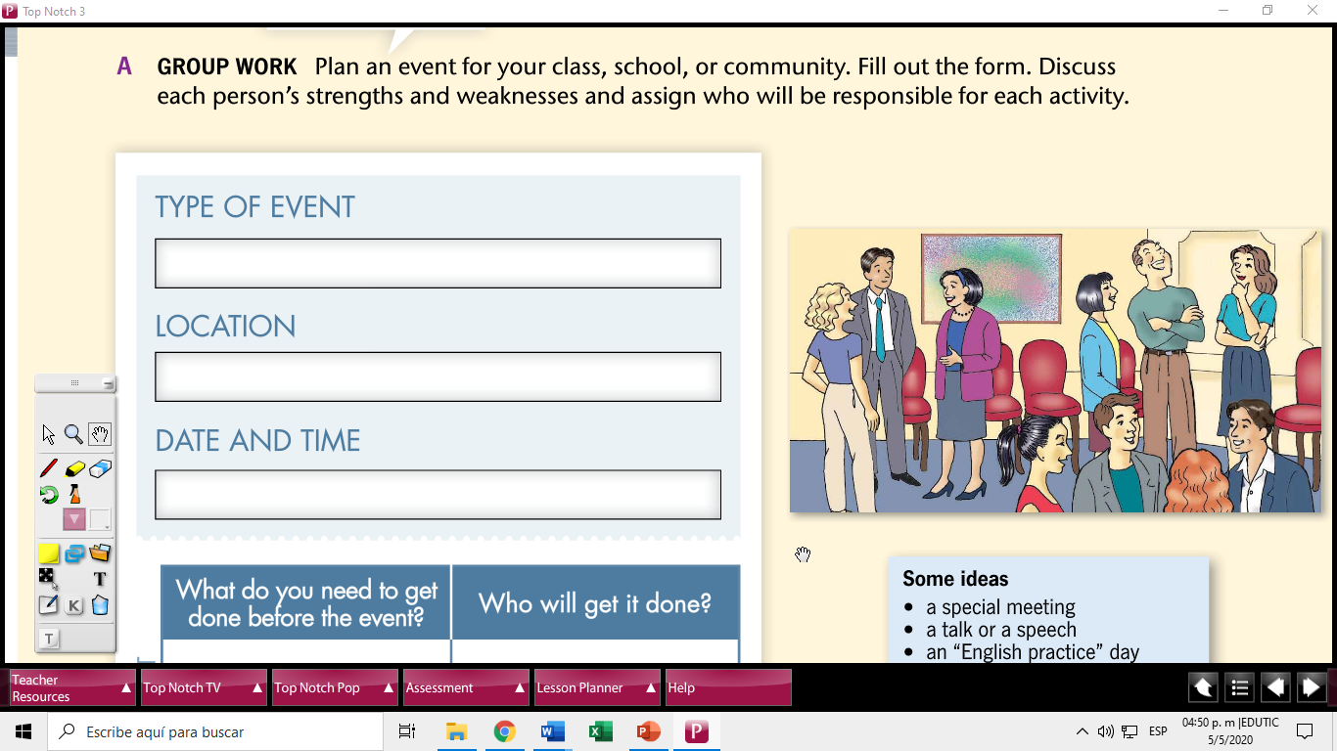
Book
If you have your book you can go to pages 34 and 35 to see well the images.
I want you to plan an evento for your class, school or community. Fill out the form on page 35.
Then make a brochure, postcard, wall-paper to promote your evento.
Examples: wedding, prom party, Mothers’ day, etc.
Can be presented digital or handmade but then you take a picture of it and send it to my email

Slide 6
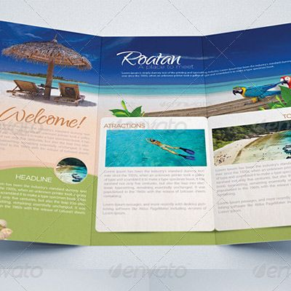
Task 1
Create your own advertising
You can give your original name to your event.
After you finish the task send your file to my email: kortega@colegiocalasanz.edu.ni ó guia9calasanz@gmail.com
Due day: May 13 th, 2020
Score: 20 pts.

