Slide 1

Welcome to your English Class
By Mrs. Karol Ortega

Slide 2
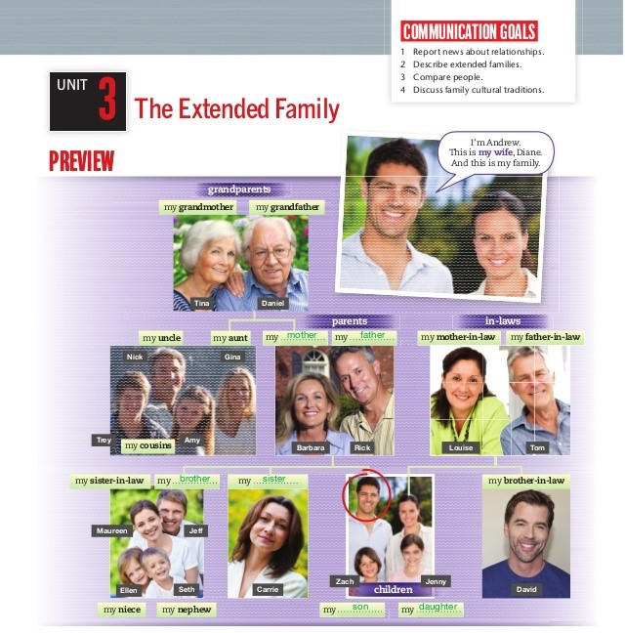
Unit 3
The extended family
Content: Vocabulary:
• The extended family
• Relationships and marital status
• Other family relationships
Objective: Design a family tree to identify family members and other relatives.

Slide 3
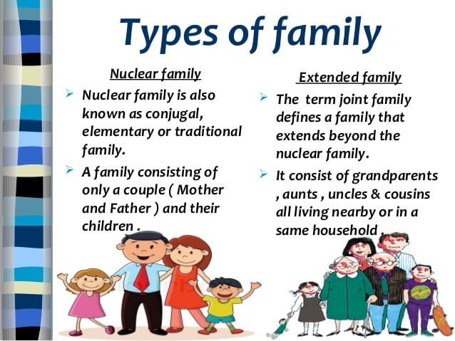

Slide 4
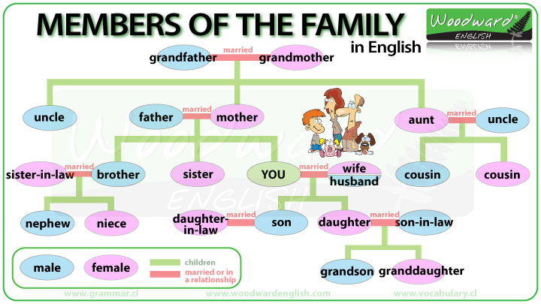

Slide 5
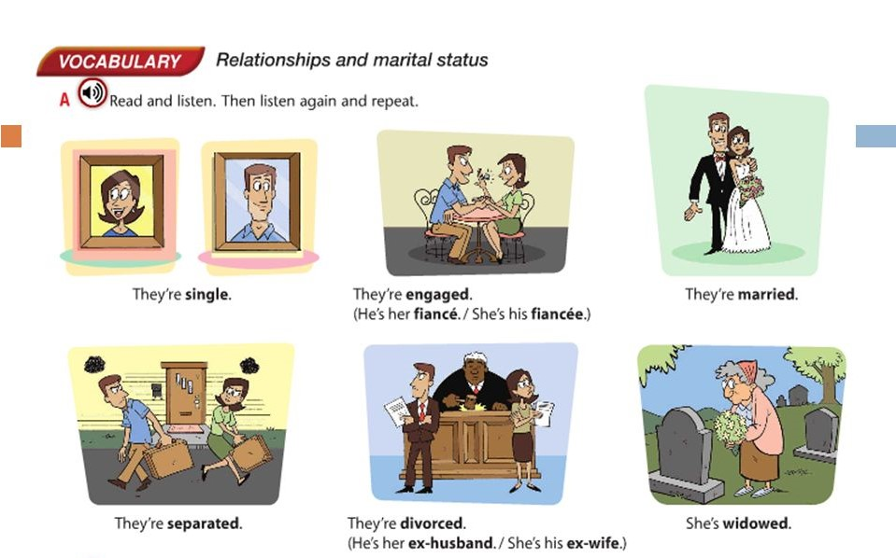
Relationships and marital status

Slide 6
Task 1
Create your family tree to identify family members and other relatives.
After you finish the family tree send your file to my email: kortega@colegiocalasanz.edu.ni ó guia9calasanz@gmail.com
Due day: May 13 th, 2020
Score: 20 pts.

