Slide 1
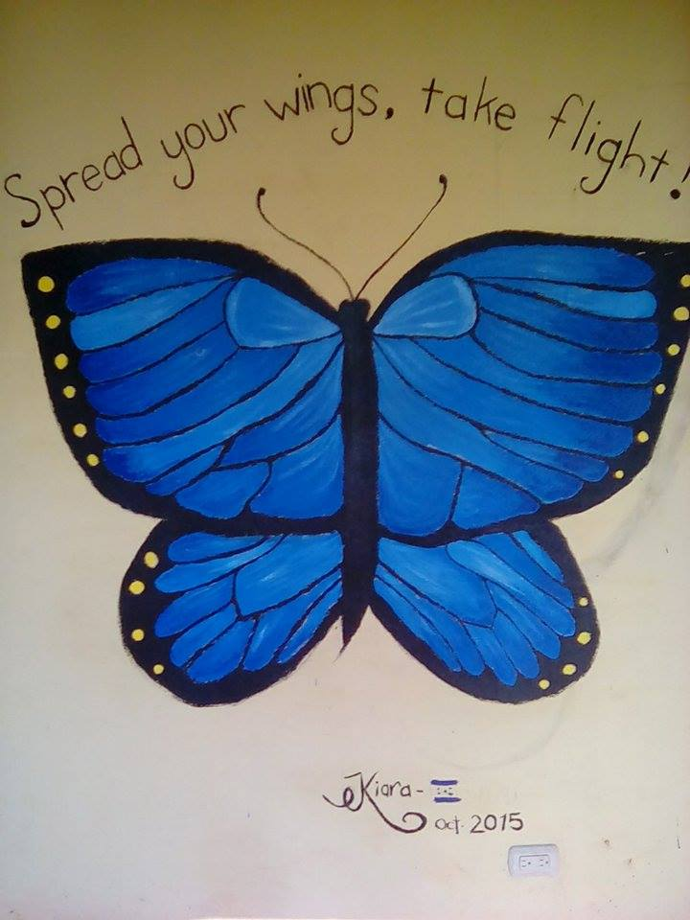
Welcome to your English Class
By Mrs. Karol Ortega

Slide 2
Unit 4
Cars and driving
Content: Vocabulary:
Bad driving habits
Car parts
Phrasal verbs for talking
about cars
Objective: Describe bad driving habits.
Describe a traffic accident

Slide 3
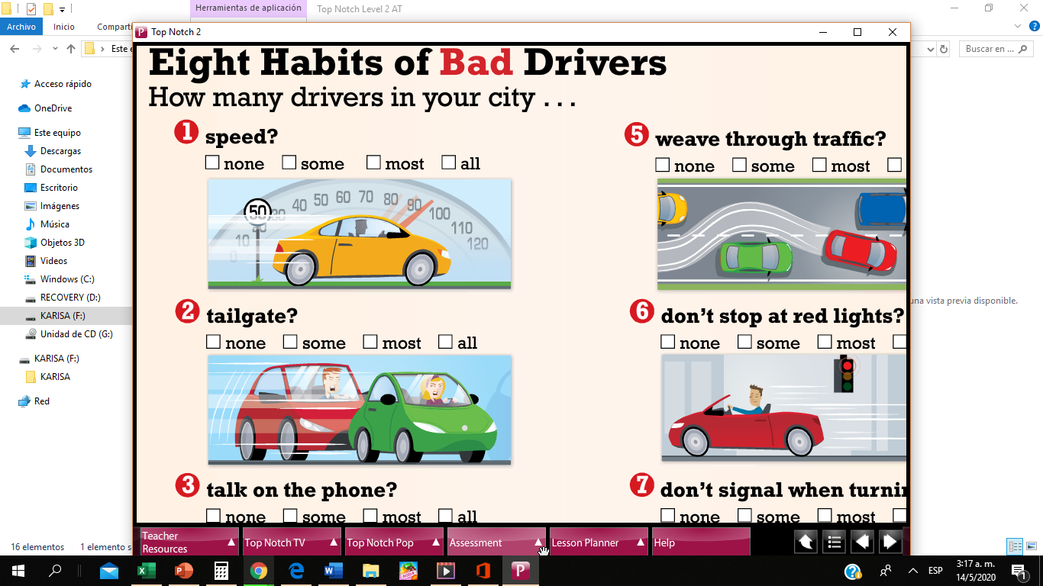

Slide 4
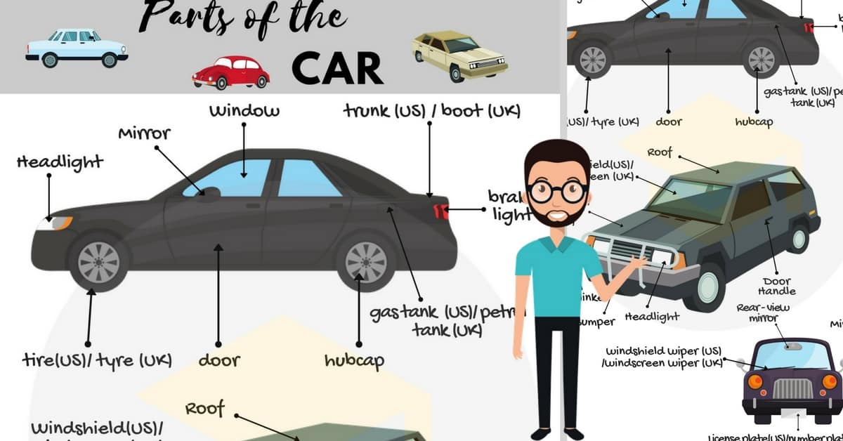

Slide 5
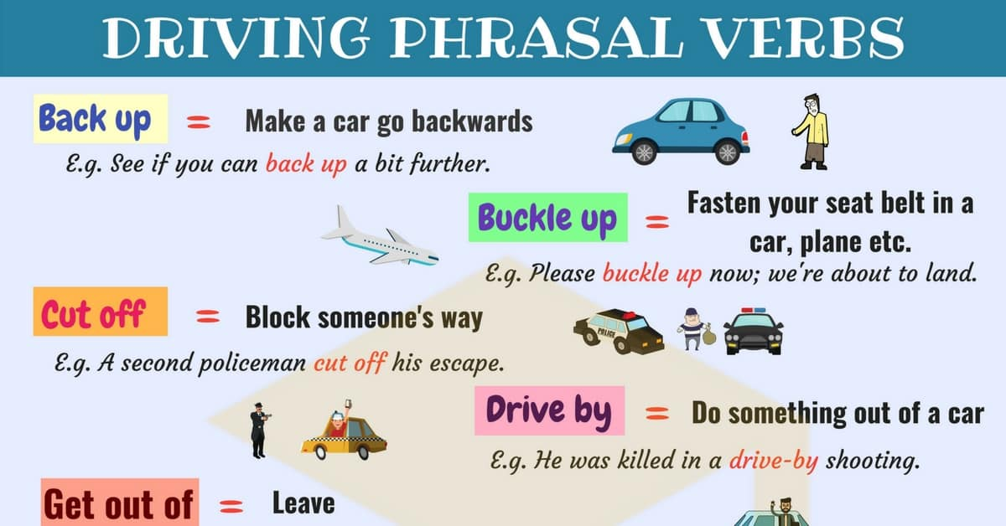

Slide 6
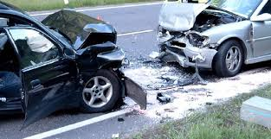
Task 2
Describe a traffic accident. In this written work you’re going to describe a personal or someone else’s experience.
The english work will be done in a Word document.
The máximum lines is 12 and the mininum 8 lines.
Add a cover page presentation if you créate adrawing for your story it’ll be amazing.
After you finish the task 2 send your file to my email: guia9calasanz@gmail.com
Due day: May 20 th, 2020
Score: 20 pts.

